Slide 1



Service marketing
(Engineering Economics and Management)
Class :- S.Y. IT-1
Name : Harsh B. Mehta
Enrol. No. : 160410116057

Slide 2
What is service marketing?
The promotion of economic activities offered by a business to its clients.
Service marketing might include the process of selling telecommunications, health treatment, financial, hospitality, car rental, air travel, and professional services.

Slide 3
The service marketing mix is also known as an extended marketing. The service marketing mix consists of 7 P’s as compared to the 4 P’s of a product marketing mix. Simply said, the service marketing mix assumes the service as a product itself. However it adds 3 more P’s which are required for optimum service delivery.
The product marketing mix consists of the 4 P’s which are Product, Pricing, Promotions and Placement.
The extended service marketing mix places 3 further P’s which include People, Process and Physical evidence. All of these factors are necessary for optimum service delivery. Let us discuss the same in further detail.

Slide 4
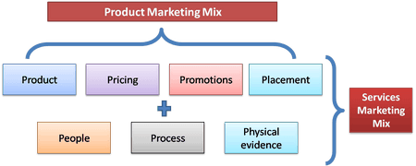

Slide 5
1) Product
The product in service marketing mix is intengible in nature. Like physical products such as a soap or a detergent, service products cannot be measured. Tourism industry or the education industry can be an excellent example. At the same time service products are heterogeneous, perishable and cannot be owned.
The service product thus has to be designed with care. Generally service blue printing is done to define the service product. For example – a restaurant blue print will be prepared before establishing a restaurant business. This service blue print defines exactly how the product (in this case the restaurant) is going to be.

Slide 6
2) Place
Place in case of services determine where is the service product going to be located. The best place to open up a petrol pump is on the highway or in the city. A place where there is minimum traffic is a wrong location to start a petrol pump. Similarly a software company will be better placed in a business hub with a lot of companies nearby rather than being placed in a town or rural area.

Slide 7
3) Promotion
Promotion have become a critical factor in the service marketing mix. Services are easy to be duplicated and hence it is generally the brand which sets a service apart from its counterpart. You will find a lot of banks and telecom companies promoting themselves rigorously.
Why is that? It is because competetition in this service sector is generally high and promotions is necessary to survive. Thus banks, IT companies, and dotcoms place themselves above the rest by advertising or promotions.

Slide 8
4) Pricing
Pricing in case of services is rather more difficult than in case of products. If you were a restaurant owner, you can price people only for the food you are serving. But then who will pay for the nice ambiance you have built up for your customers? Who will pay for the band you have for music?
Thus these elements have to be taken into consideration while costing. Generally service pricing involves taking into consideration labour, material cost and overhead costs. By adding a profit mark up you get your final service pricing. You can also read about pricing strategies.
Here on we start towards the extended service marketing mix.

Slide 9
5) People
People is one of the elements of service marketing mix. People define a service. If you have an IT company, your software engineers define you. If you have a restaurant, your chef and service staff defines you. If you are into banking, employees in your branch and their behaviour towards customers defines you. In case of service marketing, people can make or break an organization.
Thus many companies nowadays are involved into specially getting their staff trained in interpersonal skills and customer service with a focus towards customer satisfaction. In fact many companies have to undergo accreditation to show that their staff is better than the rest. Definitely a USP in case of services.

Slide 10
6) Process
Service process is the way in which a service is delivered to the end customer. Lets take the example of two very good companies – McDonallads' and FedEx. Both the companies thrive on their quick service and the reason they can do that is their confidence on their processes.
On top of it, the demand of these services is such that they have to deliver optimally without a loss in quality. Thus the process of a service company in delivering its product is of utmost importance. It is also a critical component in the service blueprint, wherein before establishing the service, the company defines exactly what should be the process of the service product reaching the end customer.

Slide 11
7) Physical Evidence
The last element in the service marketing mix is a very important element. As said before, services are intangible in nature. However, to create a better customer experience tangible elements are also delivered with the service. Take an example of a restaurant which has only chairs and tables and good food, or a restaurant which has ambient lighting, nice music along with good seating arrangement and this also serves good food. Which one will you prefer? The one with the nice ambience. That’s physical evidence.
Several times, physical evidence is used as a differentiator in service marketing. Imagine a private hospital and a government hospital. A private hospital will have plush offices and well dressed staff. Same cannot be said for a government hospital. Thus physical evidence acts as a differentiator.

Slide 12
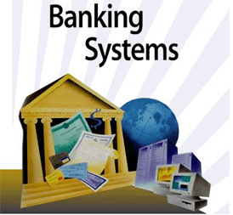
Case study
Service & Marketing in Banking:-
Problem
Solution
Result

Slide 13
Problem : 1
Once upon a time, In business and in our day-to-day life, exchange of capital was the daily process and the exchange of capital may be in very small amount or may be in very large amount . It was easy to exchange capital of low amount in cash but exchange of very large amount in cash was almost impossible. It was not easy to carry big amount with us daily. It is quite risky.

Slide 14
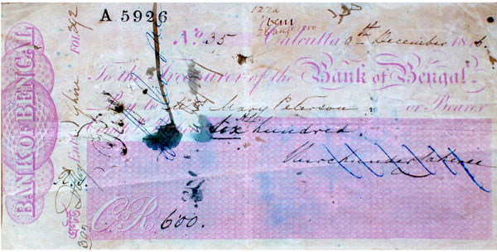
Solution:
Bengal Bank which is established in 1784 , was the first bank to provide cheque payment system to their customers. Due to this service provided by bank to their customers , around 23% of customers of other bank switch their account to the Bengal Bank.

Slide 15
Result:
As a result customers gets the safe and easy way to exchange large amount of capital.
Bank also gets new customers.

Slide 16
Problem : 2
Cheque system in not useful if the customer is out of stations or country. Also we use cheque system mostly for large capital exchange.
So what if the customer is out of station or country and want money urgently and anytime?

Slide 17
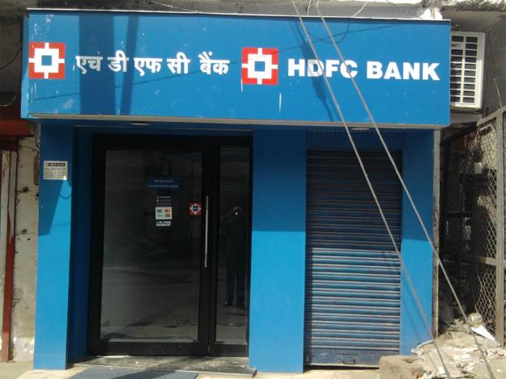
Solution:
Credit Card
HDFC was the first Indian bank which was provided credit card service to their customers in 1987.The bank installed the first ATM in Mumbai.

Slide 18
Result :
Now, People can windrow money anytime and anywhere they want. And they can save their time to stand in queue.

Slide 19


